Slide 1

Laboratory 3
Regressions
Master in Big Data Solutions 2020-2021 - Artificial Intelligence
Luis Salgueiro
luis.salgueiro@bts.tech

Slide 2

Reminder
Is this webinar being recorded?

Slide 3
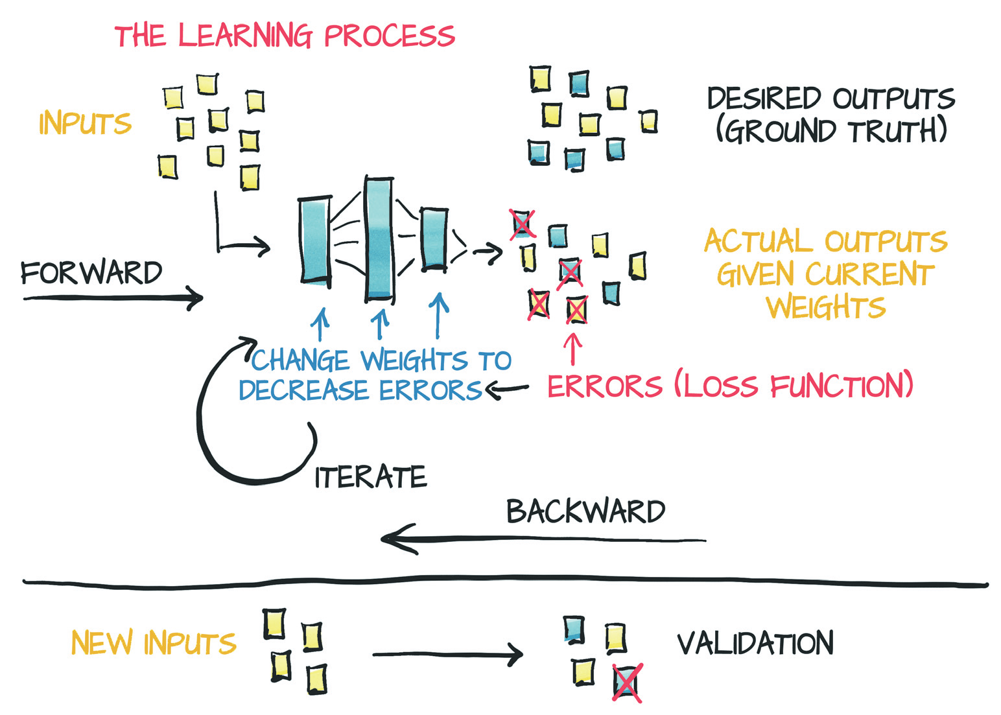
Credits: Deep Learning with Pytorch. 2020
Notes:
How exactly the machine learns?
What it is the algorithm behind that process?
From a supervised perspective, the machine takes input data and try to match or paired with desired output. Once learned, the machine is able to produce “similar” data.
In order to optimize the parameteres of the models (its weights), the errors arer computed using the chain rule and backpropagate to minimize the next errors for the next round of learning.

Slide 4
Agenda
In this lab exercises we are going to see:
How to do regressions with Pytorch.
Torch.nn module to define layers.
Torch.optim module for optimization.

Slide 5
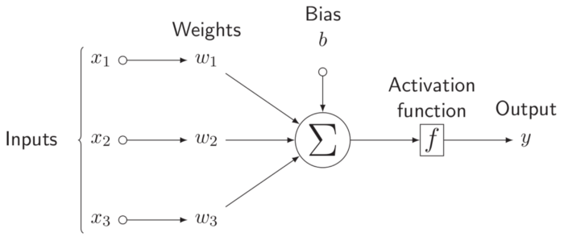
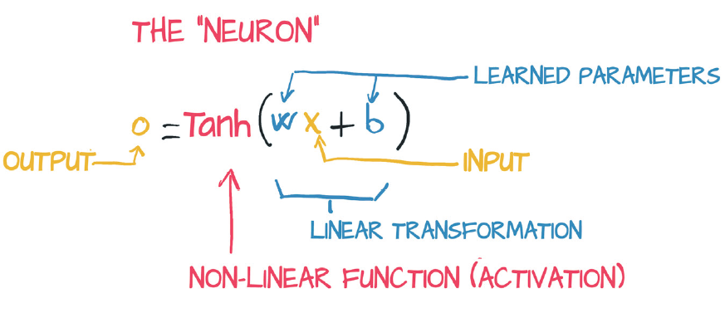
Perceptron
The perceptron is the basic unit computation in a Neural Network.
Credits: Deep Learning with Pytorch. 2020
https://tex.stackexchange.com/questions/132444/diagram-of-an-artificial-neural-network

Slide 6
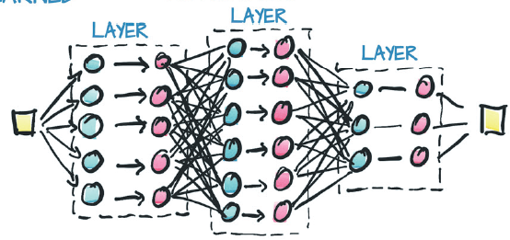
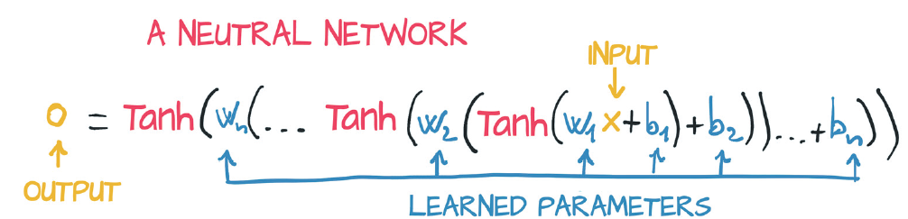
Multi-Layer Perceptron (MLP)
The connection of several perceptrons is called MLP.
The perceptrons are organized in groups called layers.
The mode in which the layers are connected is called architecture.
A MLP with 3 Layers.
Usually, the number of layers are referenced by the number of hidden layers.
Credits: Deep Learning with Pytorch. 2020
https://tex.stackexchange.com/questions/132444/diagram-of-an-artificial-neural-network

Slide 7
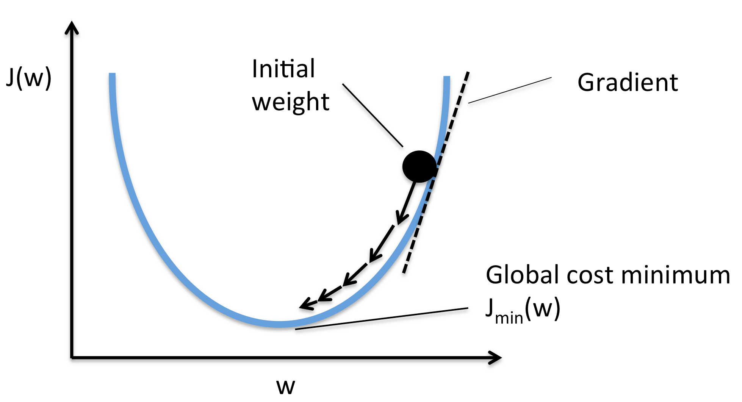

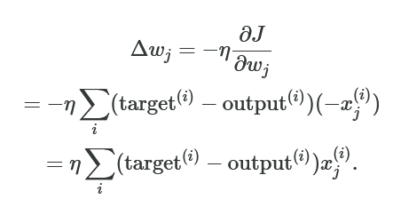

Gradient Descent
Gradient descent is the algorithm that will help us to optimize the parameters of the model.
Cost function or Loss
Sums of squared errors, with dependent variables as weights of the model.
Credits: http://rasbt.github.io/mlxtend/user_guide/general_concepts/gradient-optimization/
Notes:
The idea is to minimize this cost function and so, to compute the rate of change of the loss with respect to each parameter of the model in the direction of the decreasing loss.
What is this eta symbol represent?

Slide 8

Loss Landscape
But the reality tell us a different history.
In https://losslandscape.com there a several visual representation of the optimization process and the evolution of the performance (loss value).
AI Loss Landscape Visualization talk by Javier Ideami | Synthetic Intelligence Forum of Toronto
Notes:
The idea is to minimize this cost function and so, to compute the rate of change of the loss with respect to each parameter of the model in the direction of the decreasing loss.
What is this eta symbol represent?

Slide 9
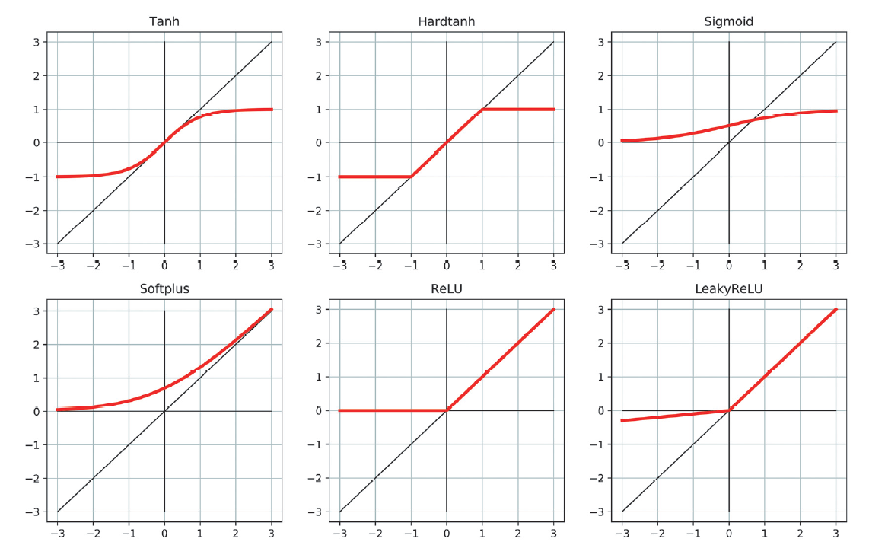
Activation functions
Provides the non-linearity component.
The functions are differentiable.
Notes:
The idea is to minimize this cost function and so, to compute the rate of change of the loss with respect to each parameter of the model in the direction of the decreasing loss.
What is this eta symbol represent?

Slide 10
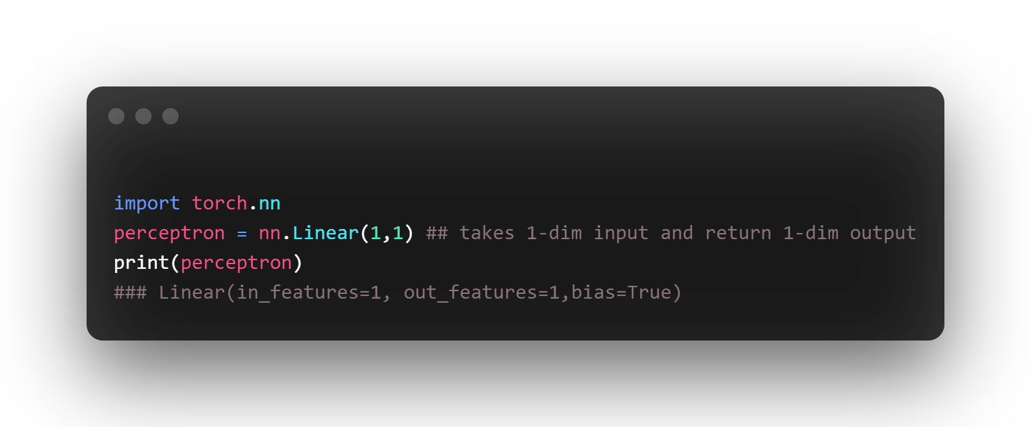
How to define layers: Torch.nn
Now, we have created a constructor for the perceptron model, that takes a 1-dim tensor as input and return a 1-dim tensor as output.
Notes:
The idea is to minimize this cost function and so, to compute the rate of change of the loss with respect to each parameter of the model in the direction of the decreasing loss.
What is this eta symbol represent?

Slide 11
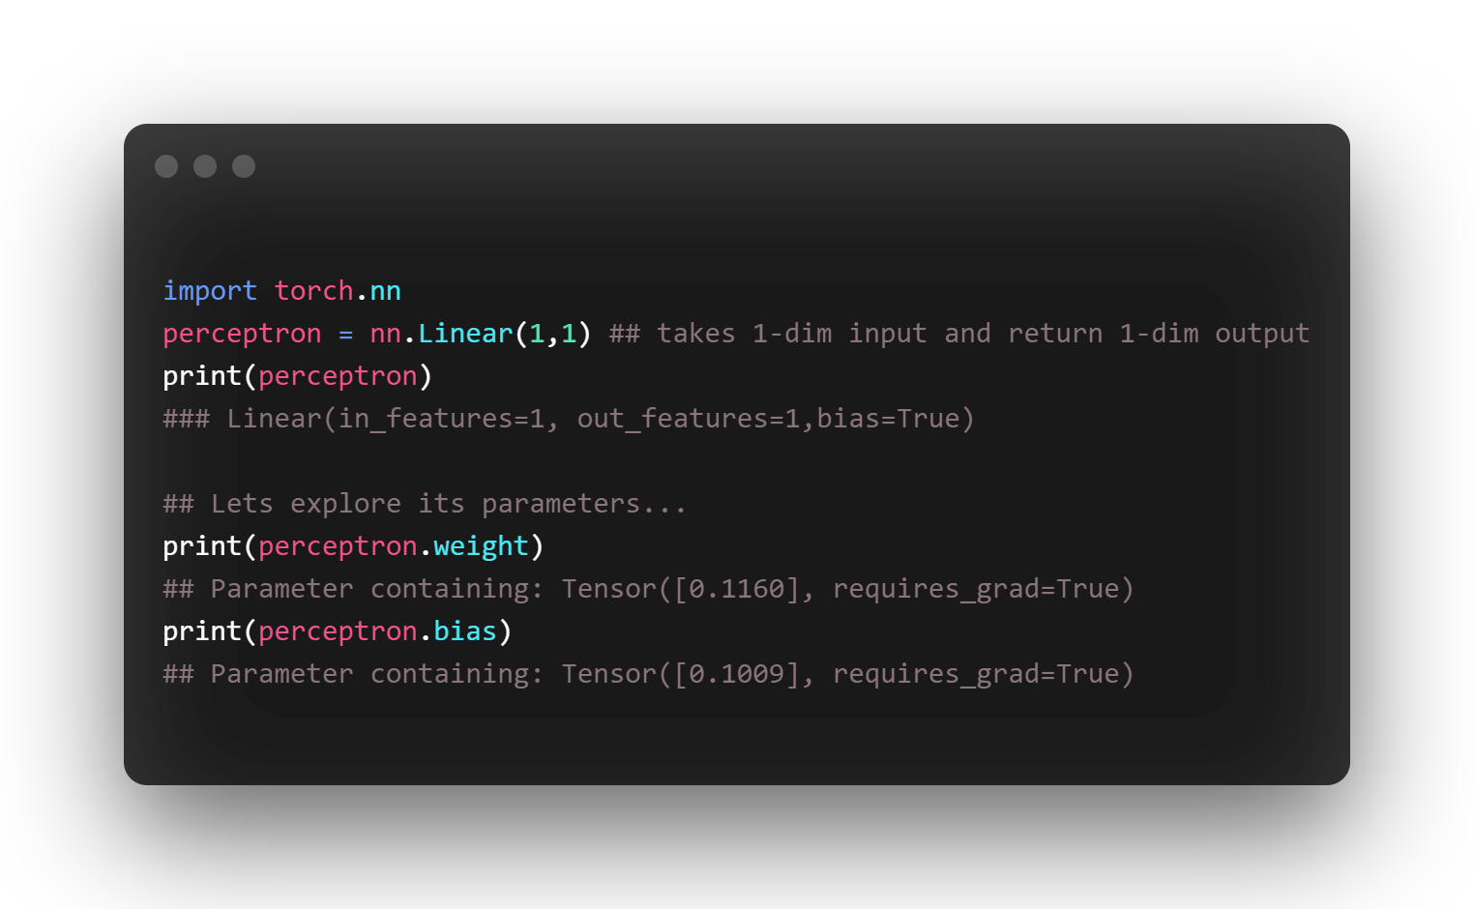
How to define layers: Torch.nn
Notice that both parameters were set with the attribute ‘requires_grad=True’ by default and initialized with random values.
Notes:
The idea is to minimize this cost function and so, to compute the rate of change of the loss with respect to each parameter of the model in the direction of the decreasing loss.
What is this eta symbol represent?

Slide 12
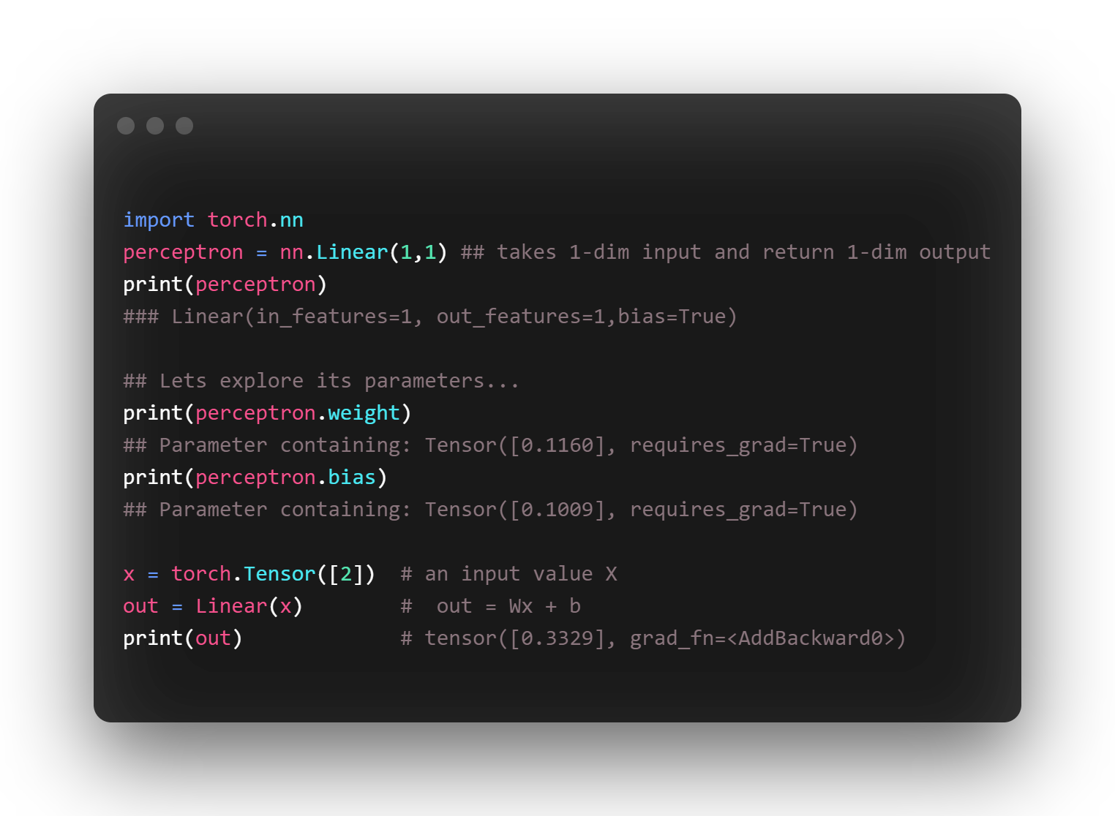
How to define layers: Torch.nn
The first forward operation.
Notes:
The idea is to minimize this cost function and so, to compute the rate of change of the loss with respect to each parameter of the model in the direction of the decreasing loss.
What is this eta symbol represent?

Slide 13
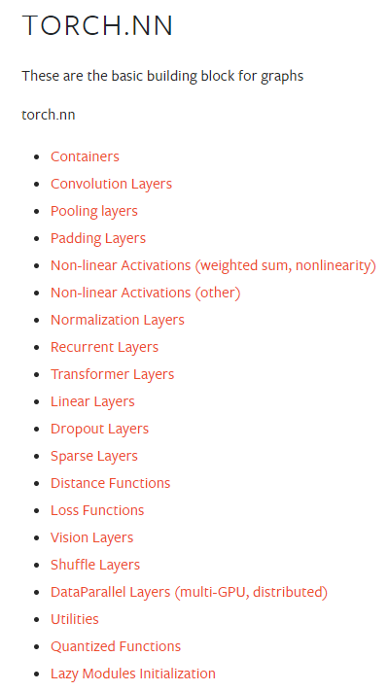
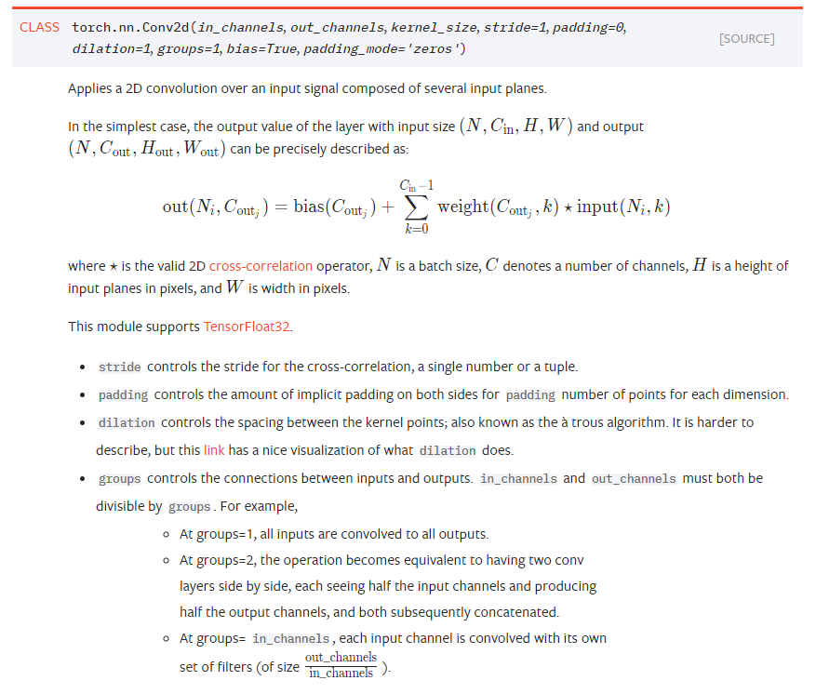
How to define layers: Torch.nn
Credits: https://pytorch.org/docs/stable/nn.html
Notes:
The idea is to minimize this cost function and so, to compute the rate of change of the loss with respect to each parameter of the model in the direction of the decreasing loss.
What is this eta symbol represent?

Slide 14
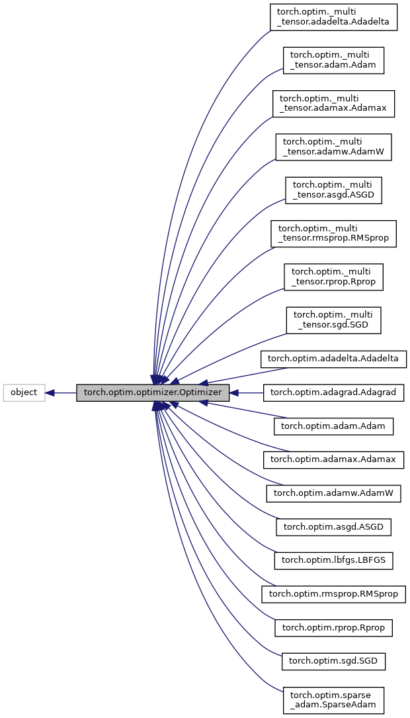
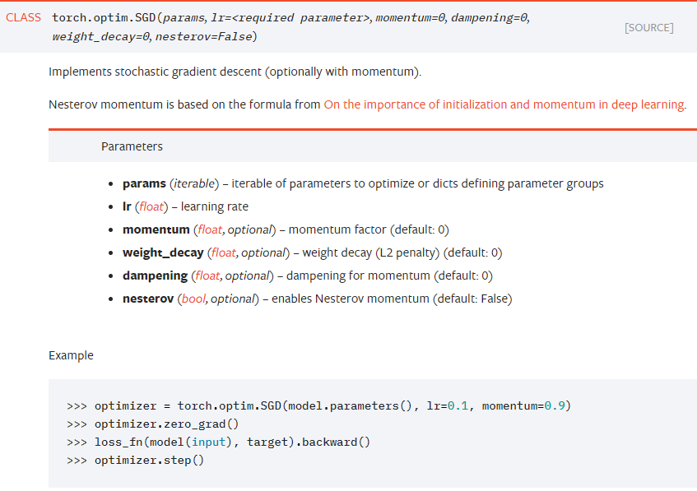
Optimization methods: Torch.optim
The optimization methods are all
gathered in torch.optim.optimizer

Slide 15
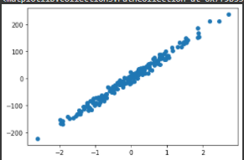
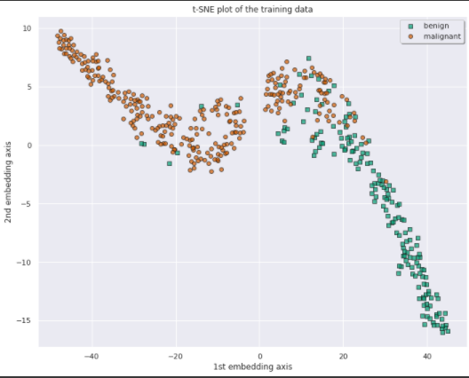
Laboratory exercises
Linear regression and Logistic Regression:
How to approximate a bunch of data
How to classify breast cancer features
Notes:
The idea is to minimize this cost function and so, to compute the rate of change of the loss with respect to each parameter of the model in the direction of the decreasing loss.
What is this eta symbol represent?

Slide 16


